Slide 1
iPhone Programming Introduction
TMA Training Center (TTC)
Course | iPhone application development
Trainer | Son Nguyen
Designed by | TMA Mobile Solutions (TMS)
Last updated | 12 May 2011

Slide 2
Document Revision History
Date | Version | Description | Revised by
12 May 2011 | 1.0 | First version | Son Nguyen
Notes:
If your document based on this template is a document that is required to control the version, you must keep this slide and fill information related to version control and fill in the fields : Owner, Reviewers, Approver, Issue date, Issue status, Document location (menu File -> Properties -> tab Custom)

Slide 3
This section objectives
Understanding about :
  Memory Management

Slide 4
Memory Management
Story
Alloc//Release
AutoRelease

Slide 5
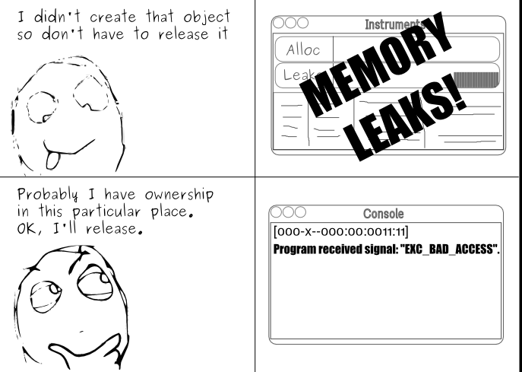
Memory Management

Slide 6
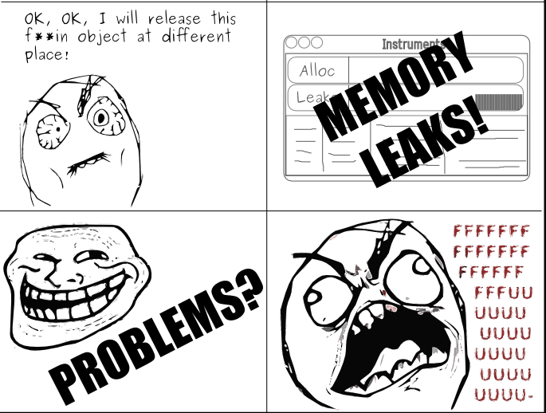
Memory Management

Slide 7

Memory Management
In Objective C on iPhoneOS, you have to manage your memory

Slide 8
Object Creation
In Objective C there is an explicit two-step object creation process:
+ alloc
  Allocate the block of memory needed for this object
  The class method which knows how much memory to allocate
- init
  Initialize the object’s state
  The instance method to set the initial values and perform other startup
  duties

Slide 9
Example
Shape *aShape = nil; //initializes memory to be 0’s and thus valid
aShape = [[Shape alloc] init];
[aShape setType:@”Triangle”];
[aShape calculatePerimeter];
// Since we are done with aShape we will call release.
// Its retain count will go to zero and thus dealloc will get called.
[aShape release];

Slide 10
Retain/Release Example
aShape = [[Shape alloc] init]; //retain count will equal one
[aShape retain]; //increment retain count by one
[aShape release]; //decrement retain count
[aShape release]; //retain count now zero, dealloc called.

Slide 11
A word about nil/NULL…
  The objects become like ‘NULL’ /nil– any attempt to access them will result in a crash:
  Shape *aShape = [[alloc Shape] init];
  // Object deallocated
  [aShape release];
  //Will result in a crash
  [aShape getPerimeter];
But if you had assigned nil to aShape right after release then no crash! Good convention

Slide 12
Autorelease
In some cases it doesn’t make sense to call release explicitely
  In below case, if you call release too early then garbage object sent
  If too late then that code will never get executed
  If no release at all (assuming not being called in dealloc) then memory leak!
- (NSString *)fullName {
NSString *result;
result = [[NSString alloc]
initWithFormat:@“%@ %@”,
firstName, lastName];
return result;
}

Slide 13
Autorelease
Method Names & Autorelease
Methods whose names includes alloc, copy, or new return a retained object that the caller needs to release
All other methods return autoreleased objects
This is a convention- follow it in methods you define!
NSMutableString *string = [[NSMutableString alloc] init];
// We are responsible for calling -release or –autorelease
[string autorelease];
NSMutableString *string = [NSMutableString string];
// The method name doesn’t indicate that we need to release

Slide 14
Autorelease cont’d
Calling -autorelease flags an object to be sent release at some point in the future
Let’s you fulfill your retain/release obligations while allowing an object some additional time to live
Makes it much more convenient to manage memory
Very useful in methods which return a newly created object

Slide 15
Autorelease cont’d
Object is added to current autorelease pool
Autorelease pools track objects scheduled to be released
When the pool itself is released, it sends -release to all its objects
If you want to keep the autorelease object for longer, call retain on it

Slide 16
Exercise
Write a program that create an object, retain it, then release it twice and display the retain count of that object in each step

Slide 17
References
http://developer.apple.com/
http://akosma.com/2009/01/28/10-iphone-memory-management-tips/

Slide 18
Question and answer
Thank you

